Slide 1
Data Science and Machine Learning Overview
Carlo Appugliese
CDO Office, Machine Learning Program Director
1

Slide 2


Transformation is Critical…
Companies must shift to a
Data-Driven Business
are vulnerable to disruption within
three years
72%
Notes:
Digital business are disrupting virtually every industry and every business. You’ve all heard about the new digital businesses:
AirBnB - The world’s largest accommodation provider owns no real estate.
Amazon - The world’s most valuable retailer carries no inventory.
Uber - The world’s largest taxi company owns no vehicles.
Facebook - The world’s most popular media owner creates no content.
But it isn’t just 100% digital businesses that are disrupting the industries, incumbents are adopting digital disruption and disrupting their industries as well.
In a recent IBM Sponsored study with Harvard Business Review, 72% of Global Line of Business leaders told us they were vulnerable to disruption WITHIN 3 YEARS.
These leaders know they need the ability to leverage data and digital technologies to understand the customer, sense markets shifts, and innovate faster than the competition. Yet only 23% say they can respond to new threats or capitalize on new opportunities

Slide 3
Saving Money….
$$$$$
“You can save 15% or more
on your operating cost by using datascience.ibm.com”
$$$$$
$$$$$

Slide 4
Making the Shift to Data Driven Organization.
Operations
Reporting & Data Warehousing
Self-Service Analytics
New Business Models
Value
Data Science
Efficiency
Modernization
Data Decision
Monetization
Uses of Data

Slide 5




What is the Buzz about with Data Science?
Business Analytics
Machine Learning
Data mining
Deep Learning
Same goal: Extracting information from data

Slide 6
What makes up a Data Scientist?
Domain Knowledge
Supply Chain
CRM
Financials
Networking
Domain Expertise
Engineering
Research
Unicorn
Scripting, SQL
Python, R Scala
Data Pipelines
Big Data/ Apache Spark
Computer
Science
Math & Stats
Machine
Learning
Mathematics
Computational

Slide 7
Future of Data Science… Democratizing Machine Learning..
2017
Innovation
Calculator
Spreadsheet
SQL
Machine Learning
IBM
1960s
Digital
IBM
1980s
Desktop
IBM
1990s
RDBMS
IBM
2010s
Open Source
2020s
AI

Slide 8
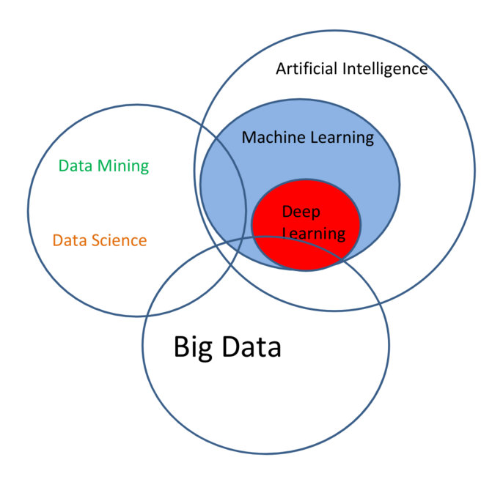
Machine learning is..
The science of getting computers to act without being explicitly programmed.
A subset of artificial intelligence.

Slide 9
Machine Learning Driving insight$ in many industries
Retail
Marketing
Healthcare
Telco
Finance
Demand forecasting
Supply chain optimization
Pricing optimization
Market segmentation
Recommendations
Recommendation & targeting
Click-stream analysis
Social media analysis
Ad optimization
Predicting patient disease risk
Diagnostics and alerts
Fraud
Customer churn
System log analysis
Preventative maintenance
Smart meter analysis
Risk analytics
Customer 360
Fraud
Credit scoring
$$$$$
$10s of Billions in many industries

Slide 10
Machine Learning 101
data
computer
data
computer
output
model
program
output
Traditional Programming
Machine Learning
Data is used to “train” a model
The data is historical data and could have known outcomes
The model can be tested by a subset of the same data
Usually a percentage of the historical data is held back
A known set of parameters is ”scored” using the model
The result is checked against the actual result from the historical data

Slide 11
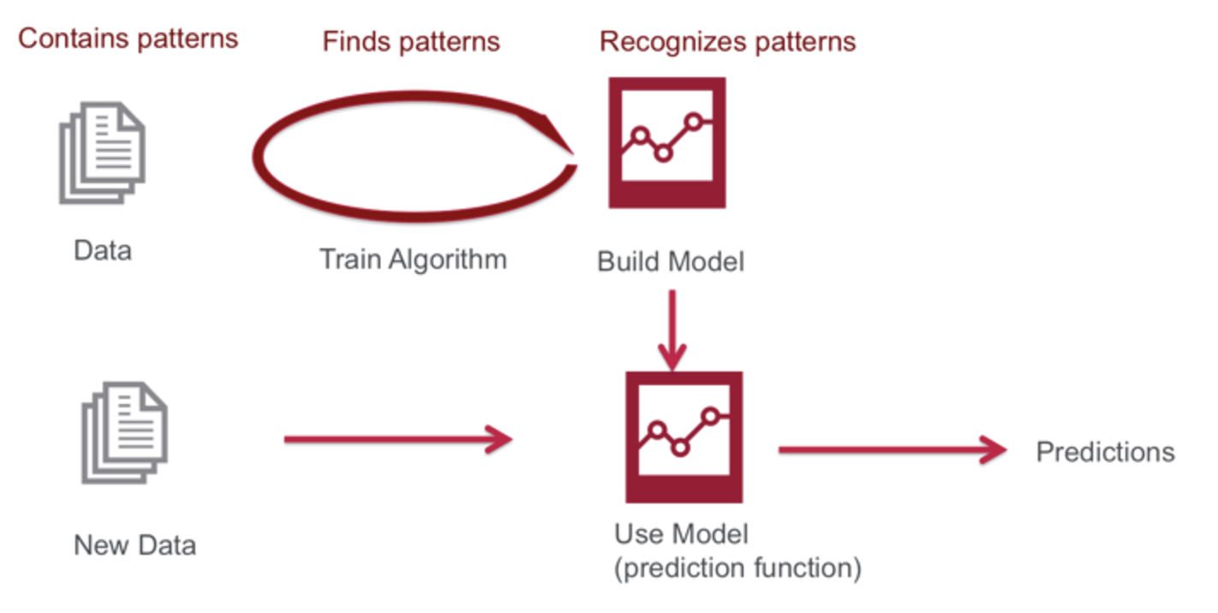
Machine Learning 101
1
Identify Patterns
not recognizable by humans
2
Build Models
from those patterns
3
Make Predictions
With the deployed models

Slide 12
Machine Learning: Loan Approval
Historical Loans
Output
John X
credit_score=800
age= 25
income=$900,000
works in Oil & Gas
Train
Algorithm
Loan
approval
Model
Target
Not Default

Slide 13
Machine Learning: Loan Approval
Output
New Applicant
James X
credit_score=800
age= 25
income=$900,000
works in Oil & Gas
Loan
approval
Model
Approve
Reject

Slide 14
Financial Services Models
Spending patterns
Credit monitoring
Portfolio tax optimization
Automated loan underwriting
Customer retention
Customized withdrawal limits
Credit increase worthiness
Customer risk scoring
Machine Learning Models
Product recommendations
Documentation review
Fraud & ID theft detection
Spending impact influencers
Sentiment & news analysis

Slide 15
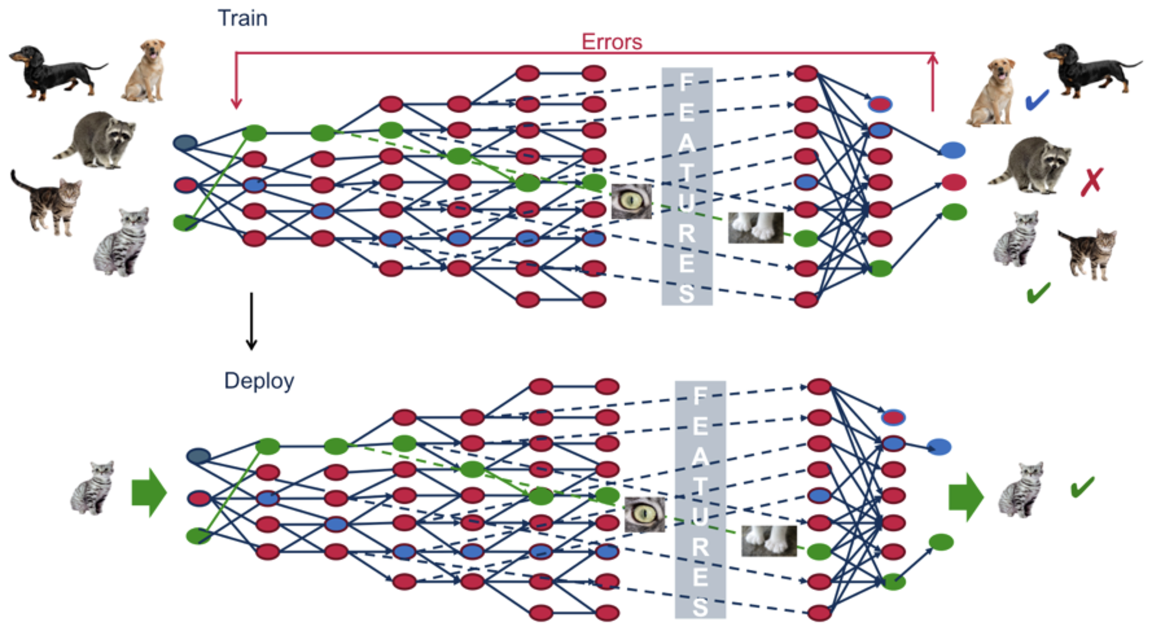
Deep learning

Slide 16

Deep Learning: Identifying an Image
Input
Output
Car
Image identification Model
Stop sign
Pedestrian

Slide 17

The Machine Learning Workflow
Models lose accuracy
Data
Algo Selection
Data Prep
Train Model
$$$
Deploy
Model
Predict
Creating examples
Choosing best model
Automating DS work
Scalable deployment

Slide 18


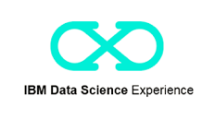

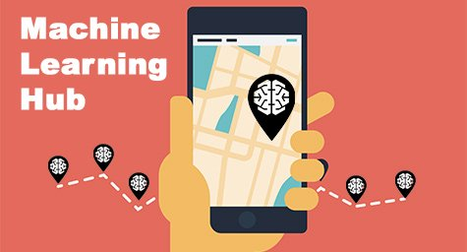
What do you need to do Machine Learning?
Data
Tools
Expertise

Slide 19








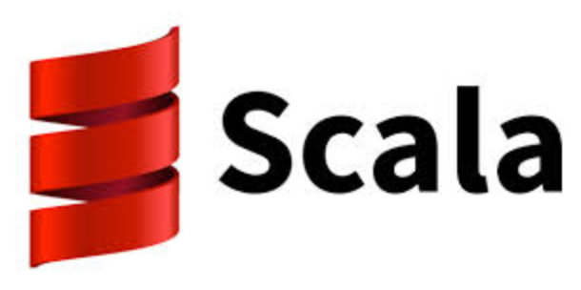




Machine Learning Everywhere – An Open Platform
Data Science Experience
IBM Analytics | Global Elite
19

Slide 20

IBM Open Data Science Platform
IBM Data Science Experience is an environment that brings together everything that a Data Scientist needs to be more productive, including tools, data and content
Be a better data scientist

Slide 21
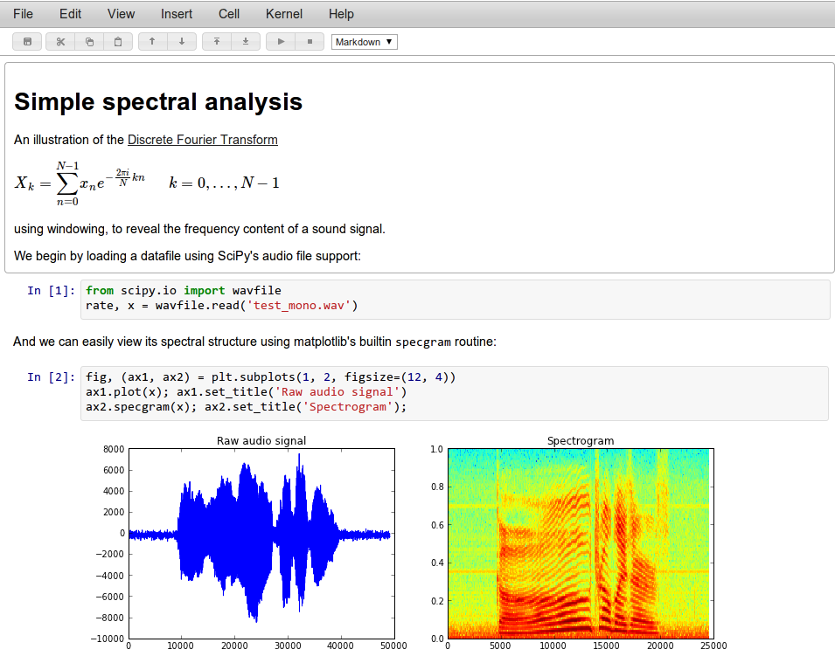

Notebooks and more…
Notebooks are interactive computational environments, in which you can combine code execution, rich text, mathematics, plots and rich media.
Notes:
A major IBM value-add in DSX is our Jupyter Notebook integration (Jupyter was derived from the iPython project – there are over 200,000 iPython notebooks on GitHub). These notebooks can be associated with a Spark service instance for scalable execution of Spark code on a Spark cluster on Bluemix. We currently support Python, Scala, and Java Spark APIs in our notebooks. They can be created from blank, file, URL, and samples.
For those of you who are not familiar with Notebooks, Notebooks allow teams to combine documentation, code, execute programs line by line, and combine the results into compelling visualizations … all within the same framework! It is a unified, single environment for collaboration – and entirely accessible by non-technical persons over a Web browser.

Slide 22


Divide by function: Similar to a surgical team, notebooks enable work to be partitioned functionally, by skill level
Resident:
Preps the patient and assists
Surgeon:
Executes all other pre and post work
Attending Surgeon:
Executes most delicate procedures requiring greatest skill
Business Analyst: Articulates problem, finds and prepares data
Data Scientist: Exploratory analysis, feature selection, deployment
Sr. Data Scientist: Builds advanced models, reviews earlier work
22
© 2016 IBM Corporation

Slide 23







IBM Open Data Science Platform
Project
People
Internal and external collaborators can be added, with relevant roles / permissions set by project owner
Artifacts
ln:
Any type of analytical asset can be part of a project, clicking on asset opens it in the right tool and in project context
ln:
ln:
ln:
ln:
ln:
Data
Each project provides its own separate storage space, available to collaborators only

Slide 24
IBM Open Data Science Platform – Machine Learning
Model Automation
Model Deployment
1
Build model
Auto-generate model from input data, testing various algorithms for best fit (e.g. CADS)
2
Deploy model
Model Builder (CADS)
Model
Capacity
Import Sources:
Deploy model into production - scale, manage and monitor
DSx Notebooks
DSx Flow UI
External tools
Predictive Power
Detect loss of predictive power and refresh model, subject to preferences
100%
3
Refresh model

Slide 25

IBM Open Data Science Platform – AI Libraries
Language
Conversa- tion
Alchemy Language
Dialog
Document Conversion
Speech
Discovery
Discovery News
Language Translator
Alchemy- Data News
Tradeoff Analytics
Natural Language Classifier
Vision
Visual Recognition
Natural Language
Under- standing
Data Insights
Text to Speech
Speech to
Text
Tone Analyzer
Retrieve and Rank
Personality Insights

Slide 26
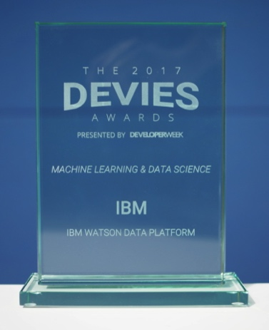
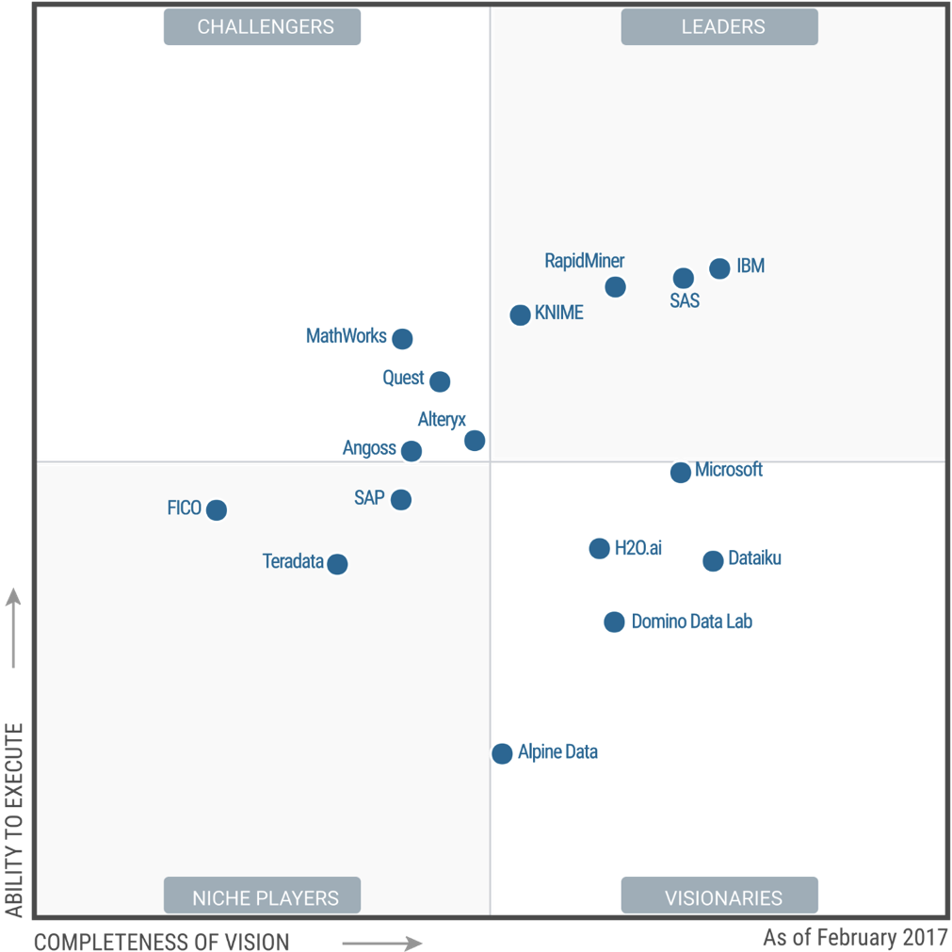
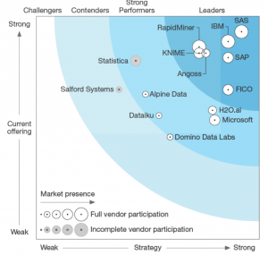
IBM Open Data Science Platform
DeveloperWeek 2017
Devie
Gartner Magic Quadrant 2017
Data Science Platforms
Forrester Wave 2017
Predictive Analytics & Machine Learning
Source: https://www.gartner.com/doc/reprints?id=1-3TKD8OH&ct=170215&st=sb
http://www.developerweek.com/awards/2017-devies-award-winners/

Slide 27

IBM Data Science Experience
Built-in Jupyter Notebooks for visualizing and coding on data science tasks using Python, R, & Scala.
Built-in RStudio and Spark framework parallelizes & accelerates data science tasks using Sparklyr and dplyr libraries.
DSX on Public Cloud
DSX Desktop
DSX Local on Private Cloud
PayGo consumption with as-a-service delivery, up & running in seconds
Integrated with IBM Spark-as-a-Service for compute, IBM Object Store for data, as well as other platform assets
Immediate cloud collaboration via RStudio and Jupyter notebooks
Easily installed on your laptop or PC
Won’t scale beyond the hardware available on your machine
Access to RStudio and Jupyter notebooks, powered by one small Spark worker operating locally on your machine
Load CSV data files into Data Frames
DSX Local can deploy with Hortonworks Data Platform on-premises
Scalable DSX cluster deployed on your private infrastructure for total isolation
“Dockerized” containers via Kubernetes
LDAP integration for user management
Meaningful collaboration via notebooks, IDEs, community, and social features

Slide 28
Thank you
IBM Analytics | Global Elite
28

